Slide 1
Chapter 1
General Probability Theory

Slide 2
1.1 Infinite Probability Spaces
Finite
Infinite
  Counterable (enumerate)
  Uncounterable (real、無理數)

Slide 3

Cardinality

Slide 4

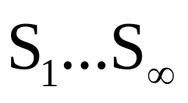


Cantor’s Diagonal Argument
S1 = (1、1、0、………)
S2 = (1、0、0、………)
S3 = (0、1、0、………)
.
.
.
= ( )
找一個S‘ = (0、1、0、………)
不屬於 的序列，但是為

Slide 5






Slide 6
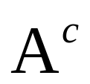
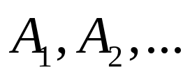
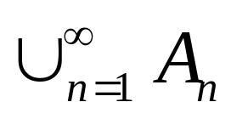
Definition 1.1.1
Let Ω be a nonempty set and let F be a collection of subsets of Ω . We say that F is a σ-algebra provided that:
  (1) the empty set φ belongs to F
  (2) whenever a set A belongs to F, its
  complement also belongs to F
  (3) whenever a sequence of sets belongs
  to F, their union also belongs to F

Slide 7
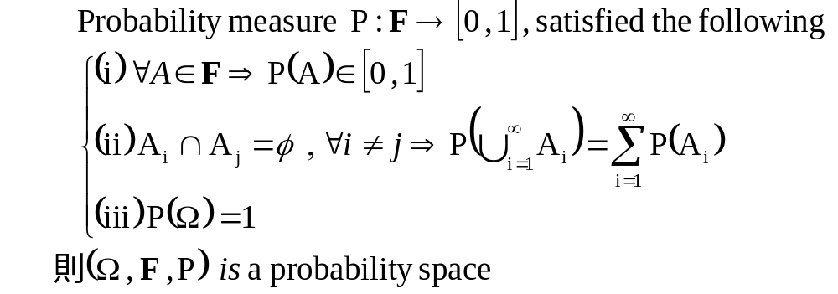
Definition 1.1.2

Slide 8
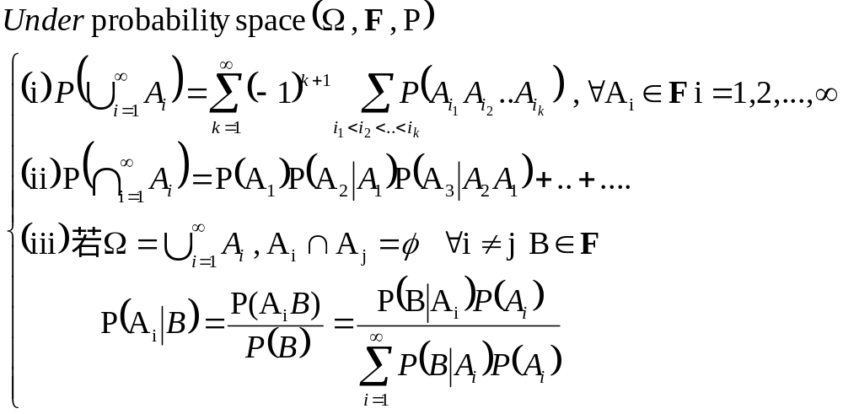

Slide 9
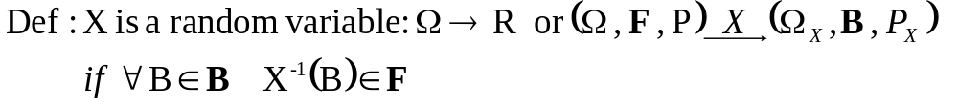
Note

Slide 10
σ-algebra:資訊集合
假定有一個色盲,不能分辨顏色,只能分辨“正” “反”
  “正” 事件→ {“紅正”,“綠正”}
  “反” 事件→ {“紅反”,“綠反”}
  色盲的資訊集合F1={Ω,φ, {“紅正”,“綠正”}, {“紅反”,“綠反”}}
假定有一個文盲,不能分辨文字,只能分辨“紅” “綠”
  “紅” 事件→ {“紅正”,“紅反”}
  “綠” 事件→ {“綠正”,“綠反”}
  文盲的資訊集合F2={Ω,φ, {“紅正”,“紅反”}, {“綠正”,“綠反”}}

Slide 11
σ-algebra:資訊集合
當色盲和文盲溝通,就可透過推論辨別文字和顏色
  Ex: {“紅正”,“綠正”}∩ {“紅正”,“紅反”}={“紅正”}
  {“紅正”,“綠正”}∪ {“紅正”,“紅反”}={“紅正”,“綠正”, “紅反”}→ “綠反”事件未發生

Slide 12

σ-algebra:資訊集合
文盲和色盲溝通後建立新的資訊集合F
F= {Ω,φ,
{“紅正”,“綠正”}, {“紅反”,“綠反”},
{“紅正”,“紅反”}, {“綠正”,“綠反”},
{“紅正”},{“綠正”},{“紅反”},{“綠反”}
{“紅正”,“綠反”}, {“綠正”,“紅反”},
{“紅正”,“綠正”,“紅反”},{“紅正”,“綠正”,“綠反”},
{“紅正”,“紅反”,“綠反”},{“紅反”,“綠正”,“綠反”},
}
兩個人的資訊集合
共 元素
再做推論

Slide 13
Example 1.1.3
(Uniform (Lebesgue) measure on [0,1])

Slide 14
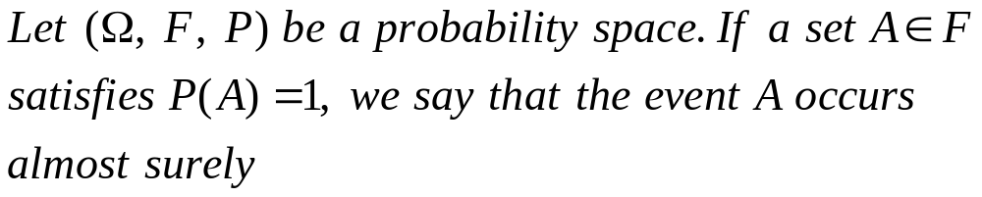
Definition 1.1.5

